Slide 1
Application Layer Protocols
Course Code: CSC 3116
Course Title: Computer Networks
Dept. of Computer Science
Faculty of Science and Technology
Lecturer No: | 2 | Week No: | 2 | Semester: | spring 21-22

Slide 2
Lecture Outline
1. Different layers of Protocol
2. Protocol Types
3. HTTP
4. DNS

Slide 3
What is Protocol?
Protocol:
In computer networks, communication occurs between entities in different systems.
However, two entities can not simply send bit streams to each other and expect to be understood.
For communication to occur, the entities must agree on a protocol.
A protocol is a set of rules that govern data communications.
A protocol defines what is communicated, how it is communicated, and when it is communicated.
Example: HTTP, FTP, TCP,IP etc.

Slide 4
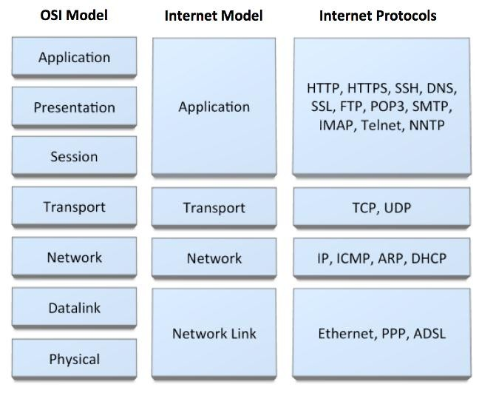
Different Layers Protocol

Slide 5
Protocol Types
PUSH protocol:
In push protocols, the client opens a connection to the server and keeps it constantly active.
The server will send (push) all new events to the client using that single always-on connection.
In other words, the server PUSHes the new events to the client. Example: SMTP

Slide 6
PULL protocol:
In pull protocols, the client periodically connects to the server
And checks for and gets (pulls) recent events and then closes the connection and disconnects from the server.
The client repeats this whole procedure to get updated about new events.
In this mode, the clients periodically PULLs the new events from the server. Example: HTTP

Slide 7
Application Layer Protocol: HTTP
HTTP (Hypertext Transfer Protocol) is used across the world wide web (www) for data transfer and is one of the most used application protocols.
HTTP specifies a request/response protocol.
When a client, typically a web browser, it sends a request message to a server,
The HTTP protocol defines the message types , the client uses to request the web page and
The message types the server uses to respond
The three common message types are:
  GET POST PUT

Slide 8
Application Layer Protocol: HTTP (c o n t .)
GET: It is a client request for data.
A web browser sends the GET message to request pages from a web server.
As shown in Figure, when the server receives the GET request,
It responds with a status line, such as HTTP/1.1 200 OK, and a message of its own,
The body of which can be the requested file, an error message, or some other information.

Slide 9
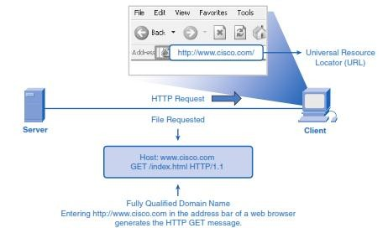

Slide 10
Application Layer Protocol: HTTP (c o n t .)
POST and PUT are used to send messages that upload data to the web server.
For example, when the user enters data into a form embedded in a web page, POST includes
the data in the message sent to the server.
PUT uploads resources or content to the web server.

Slide 11
Application Layer Protocol: HTTP runs on T C P
The transfer protocol used throughout the World Wide Web is HTTP (Hyper Text Transfer Protocol).
TCP provides a reliable data transfer service to HTTP, using TCP port 80.
This implies that each HTTP request message emitted by a client process eventually arrives in tact at the server; similarly, each HTTP response message emitted by the server process eventually arrives in tact at the client.
HTTP need not worry about lost data, or the details of how TCP recovers from loss or reordering of data within the network.

Slide 12
Application Layer Protocol: D N S
Domain Name Service (DNS):DNS is a host name to IP address translation service. DNS is a distributed database implemented in a hierarchy of name servers. It is an application layer protocol for message exchange between clients and servers.
Every host is identified by the IP address but remembering numbers is very difficult for the people and also the IP addresses are not static therefore a mapping is required to change the domain name to IP address. So DNS is used to convert the domain name of the websites to their numerical IP address.
There are three types of name servers:
Root name servers
Local name server
Authoritative name servers

Slide 13
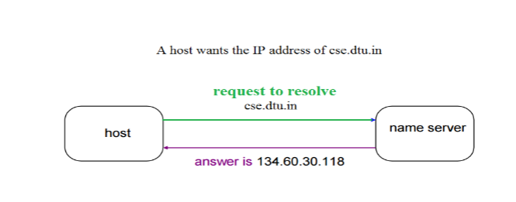
DNS Contd..

Slide 14
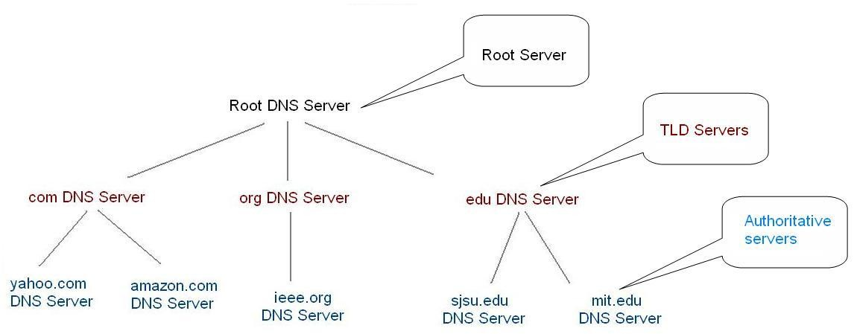
D N S Hierarchy
Notes:
top-level domain

Slide 15
Root name servers –
It is contacted by name servers that can not resolve the name.
It contacts authoritative name server if name mapping is not known.
It then gets the mapping and return the IP address to the host.
Top level server –
It is responsible for com, org, edu etc and all top level country domains like uk, fr, ca, in etc.
They have information about authoritative domain servers and know names and IP addresses of each authoritative name server for the second level domains.

Slide 16
Authoritative name servers
This is organization’s DNS server, providing authoritative host Name to IP mapping for organization servers.
It can be maintained by organization or service provider.
In order to reach cse.dtu.in we have to ask the root DNS server, then it will point out to the top level domain server and then to authoritative domain name server which actually contains the IP address.
So the authoritative domain server will return the associative ip address.

Slide 17
Internet Domain Names
As an example, consider a namespace with names of the form:
  local. site
where site is the site name authorized by the central authority, local is the part of a name controlled by the site, and (".") is a delimiter used to separate them.
adding a group subdivision to names already partitioned by site produces the following name syntax:
local. group. site

Slide 18
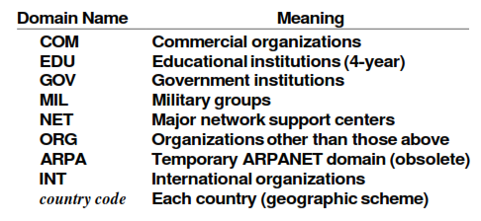
Internet Domain Names (cont .)
Example: cs .purdue . edu
contains three labels: cs, purdue, and edu. Any suffix of a label in a domain name is also called a domain. In the above example the lowest level domain is cs .purdue. edu, (the domain name for the Computer Science Department at Purdue University), the second level domain is purdue. edu (the domain name for Purdue University), and the top-level domain is edu (the domain name for educational institutions). As the example shows, domain names are written with the local label first and the top domain last.

Slide 19
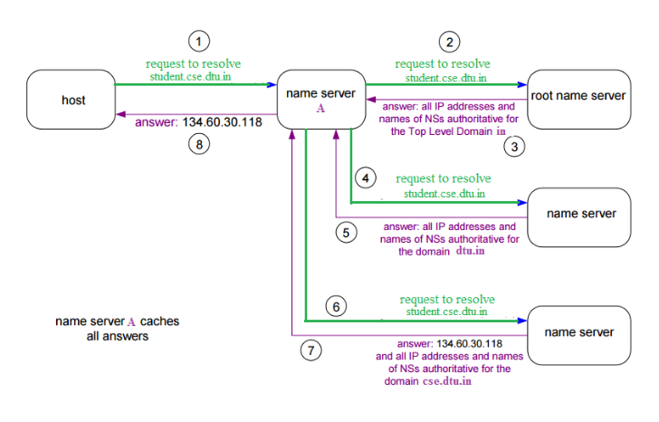

Slide 20
The client machine sends a request to the local name server, which , if root does not find the address in its database, sends a request to the root name server , which in turn, will route the query to an intermediate or authoritative name server.
The root name server can also contain some host Name to IP address mappings. The intermediate name server always knows who the authoritative name server is. So finally the IP address is returned to the local name server which in turn returns the IP address to the host.

Slide 21
Different types of D N S queries
DNS queries can be classified according the manner in which a complete request is processed. Generally queries can be classified as follows.
Recursive query: A recursive query is a kind of query, in which the DNS server, who received the sender’s query will do all the job of fetching the answer, and giving it back to the sender.
During this process, the DNS server might also query other DNS server's in the internet of the sender’s behalf, for the answer.
Iterative query OR Nonrecursive query: In an iterative query, the name server, will not go and fetch the complete answer for the sender’s query, but will give back a referral to other DNS server's, which might have the answer.

Slide 22
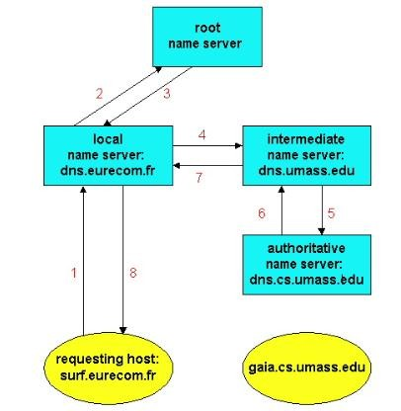
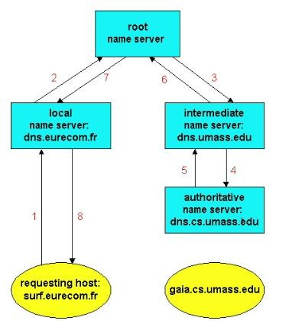
Recursive query/ Iterative query
Fig: A query chain with iterative queries.
Fig: A query chain with recursive queries.

Slide 23
References
  Data Communications and Networking, B. A. Forouzan, McGraw-Hill, Inc., Fourth Edition, 2007, USA.
  https://www.geeksforgeeks.org/basics-computer-networking/
  https://www.tutorialspoint.com/computer_fundamentals/computer_networking.htm

Slide 24
Books
  Data Communications and Networking, B. A. Forouzan, McGraw-Hill, Inc., Fourth Edition, 2007, USA.
  Computer Networking: A Top-Down Approach, J. F., Kurose, K. W. Ross, Pearson Education, Inc., Sixth Edition, USA.
  Official Cert Guide CCNA 200-301 , vol. 1, W. Odom, Cisco Press, First Edition, 2019, USA.
  CCNA Routing and Switching, T. Lammle, John Wily & Sons, Second Edition, 2016, USA.
  TCP/IP Protocol Suite, B. A. Forouzan, McGraw-Hill, Inc., Fourth Edition, 2009, USA.
  Data and Computer Communication, W. Stallings, Pearson Education, Inc., 10th Education, 2013, USA.

